Slide 1
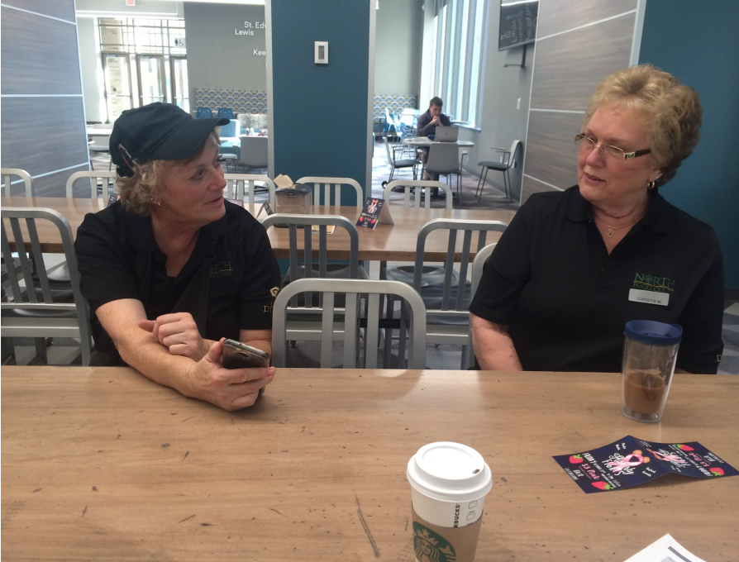

CITY OF SOUTH BEND
INCLUSIVE TECHNOLOGY RESOURCE CENTER
Curriculum & Programming
UNIVERSITY OF NOTRE DAME // Design Research Practices
Christina Allende, Eva Ferrao, Jacob Rush, Sam Walker
December 7, 2017

Slide 2


THE WORLD IS MOVING FORWARD FOR THOSE WHO KNOW HOW TO MOVE FORWARD WITH IT
Adriana, 45
Startup Stock Photos
Notes:
Erin

Slide 3
Curriculum Goals
Encourage proactive use and comfort with technology for personal and professional growth
Change perceptions of tech from intimidating to beneficial
Engage community organizations to reach a greater audience
Notes:
Erin
emphasize merging gap

Slide 4
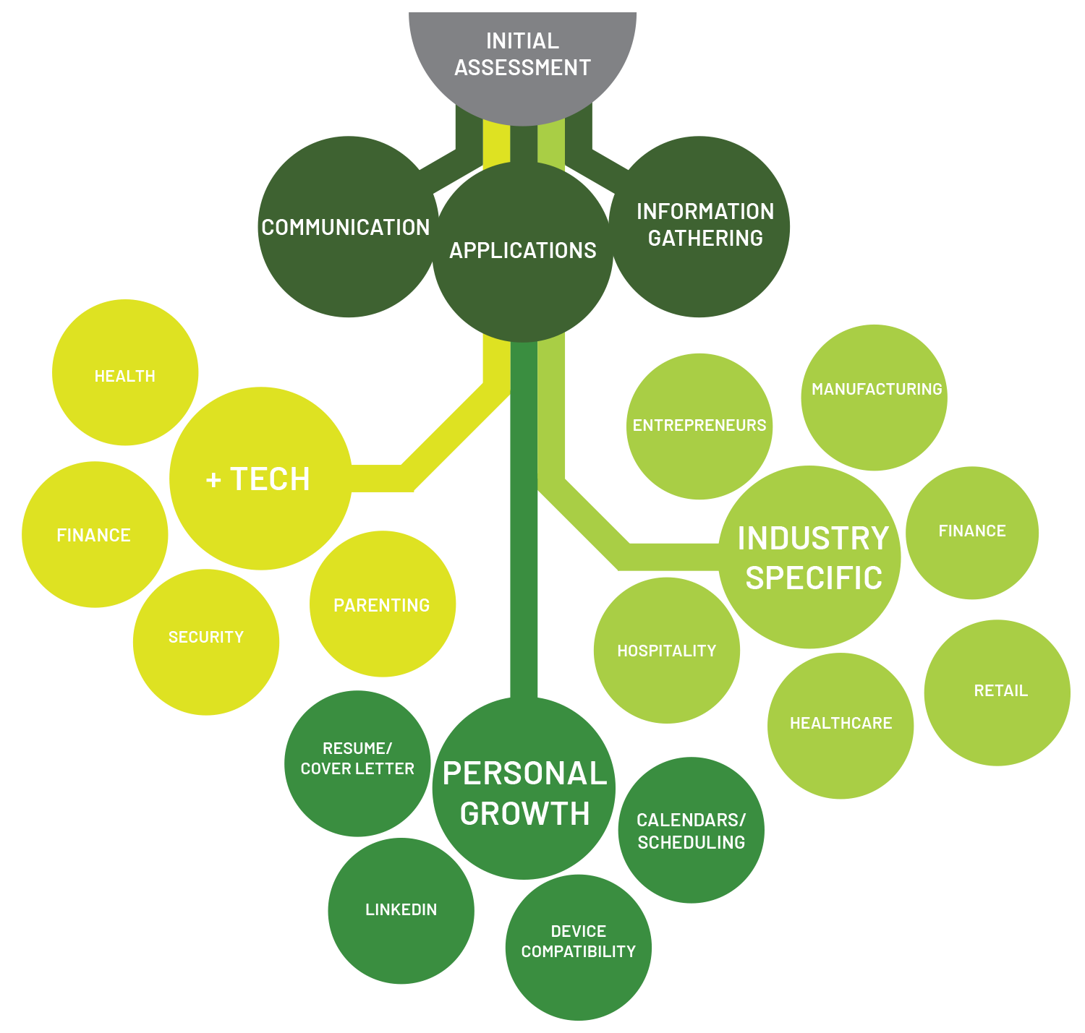
Curriculum Overview
Daily Life
Specialized Activities

Slide 5
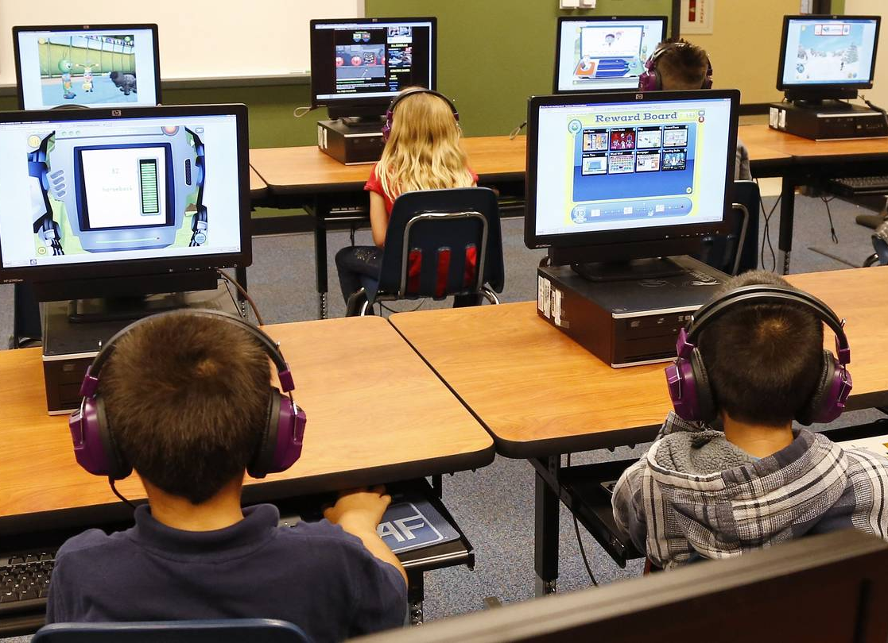
Promote tech literacy as a pathway to addressing more important needs

Slide 6
Tech in Daily Life
Enhance tech skills to stimulate a more resourceful lifestyle

Slide 7


Communication in Daily Life
Taking advantage of technology to change the way people connect & communicate
Social Media Platforms
Messaging
International Connection
Email
Video Chats
Photo sharing

Slide 8
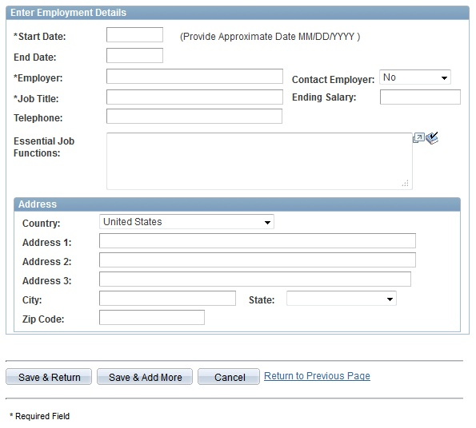
Applications in Daily Life
Learning how to complete electronic applications
Username/password and account creation
Download/save/access/upload documents
Store personal information and key documents for easy access
Apply for benefits, jobs, memberships and legal documentation

Slide 9

Info Gathering in Daily Life
Navigating the web to effectively find information
Google / search engines
Search strategies
Data storage & access
Identifying reliable sources
Downloading apps

Slide 10

Spark tech confidence in those who feel tech illiterate

Slide 11
Assessment & Daily Life Literacy
Determine current level of tech understanding and their ability to take full advantage of the benefits
Identify ability to understand, use and safely interact with digital resources
Ask open-ended questions to encourage narratives and detailed responses
Decipher tasks achieved through computers or mobile devices and preferences
Primarily smartphone users are limited in:
formatting/saving and transmitting documents
filling in online applications
troubleshooting
protect themselves online
keyboard efficiencies and shortcuts
financial transactions

Slide 12
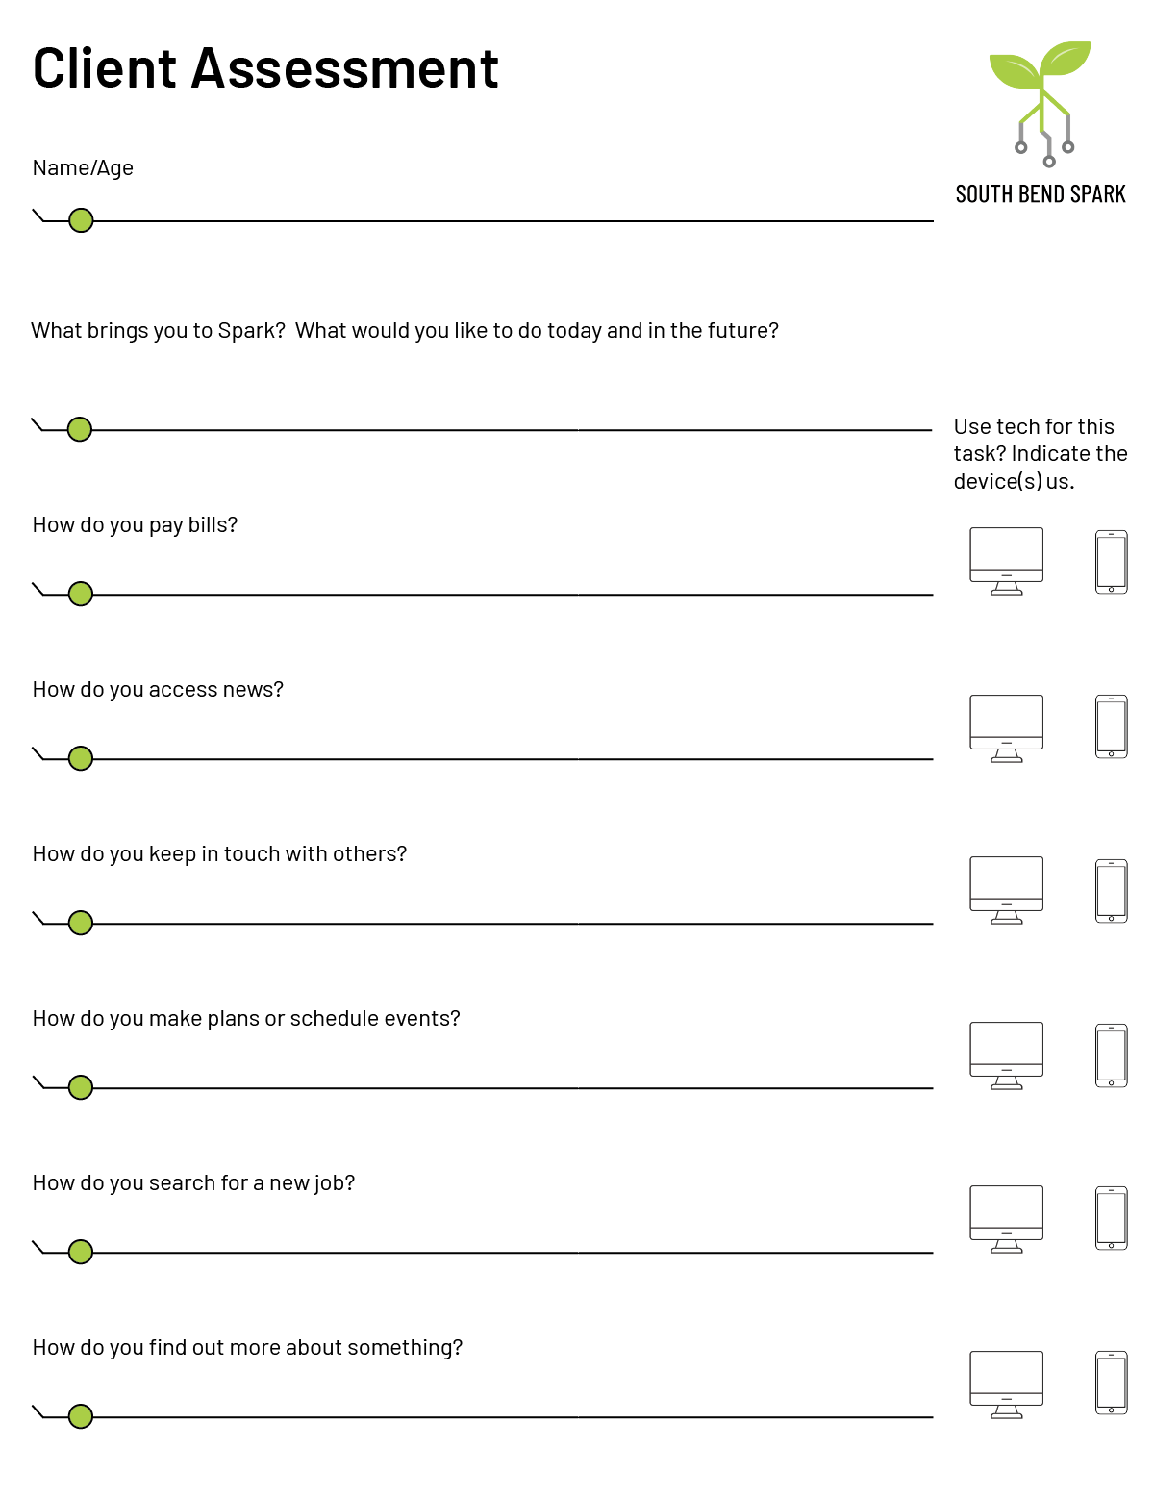
Assessment & Daily Life Literacy
Assessments are conducted by staff who interview and get to know clients. It may also be done at a SparkSITE by resource staff who have been trained in the curriculum.
Clients are asked to show staff their phone and how they use it for various tasks allowing observation of comfort and proficiency.

Slide 13
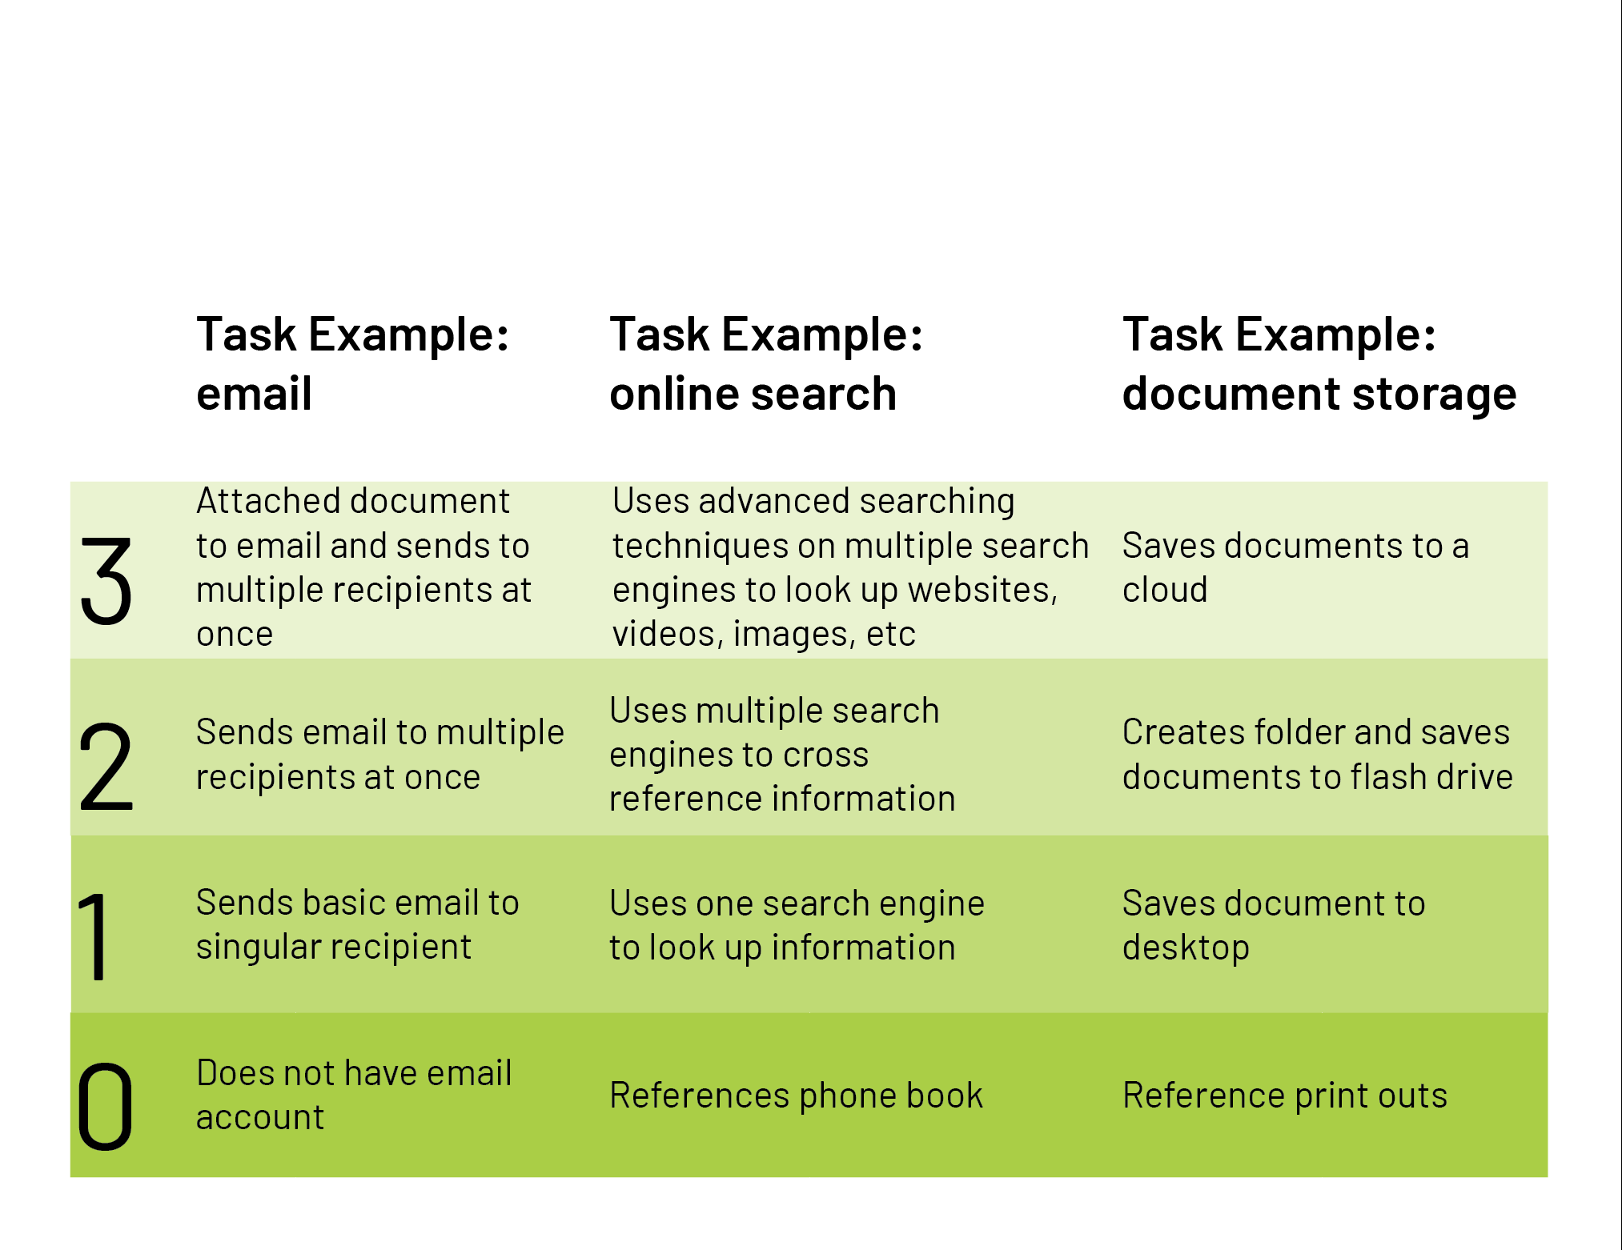
Assessment & Daily Life Literacy
Shifting from a literacy model based on applications to one based on tasks

Slide 14

Peer Learning
Members feel more comfortable interacting with teachers who are also their peers
Fosters a team-building spirit and provides tangible end-goals
Reinforces teachers own learning
Preparation for other real life social and employment situations

Slide 15

Spark interest by giving tech purpose; don’t just teach for tech’s sake

Slide 16
+Tech
An inside out approach to generating a purpose for tech

Slide 17

Finances +Tech
Learning how to electronically keep track of your finances
Payroll card transactions
Online Banking
Paying Bills
Online Shopping
Budgeting
Jacob Titus
Instagram: @west.sb

Slide 18

Health +Tech
Use Tech to help manage your health
Beacon Connected Care
Medicare/Medicaid
WebMD / health resources
Prescription Refills
Medication Adherence

Slide 19

Security +Tech
“I’ve found resumes, divorce papers, immigration documents on library computers. I collect them on a flash drive for laughs.” - John, 66
Uncovering real & perceived risks of computers and internet
Safe vs. Risky Websites
Securely Save Documents
Using Credit Cards Online
Virus prevention

Slide 20

Online Parenting +Tech
Keep your children safe in the new world of interconnectivity
Online Gaming
Social Media
Dangerous Websites
Find my (child) iphone
Monitoring teens online

Slide 21
+Tech
Implementation

Slide 22

Leverage ubiquity of smartphones as a gateway to tech confidence

Slide 23

Phone to Computer Courses
Task driven course simultaneously using both computer and smartphone
Compares advantages and disadvantages of software on differing devices
Gives members confidence in their existing tech skills

Slide 24
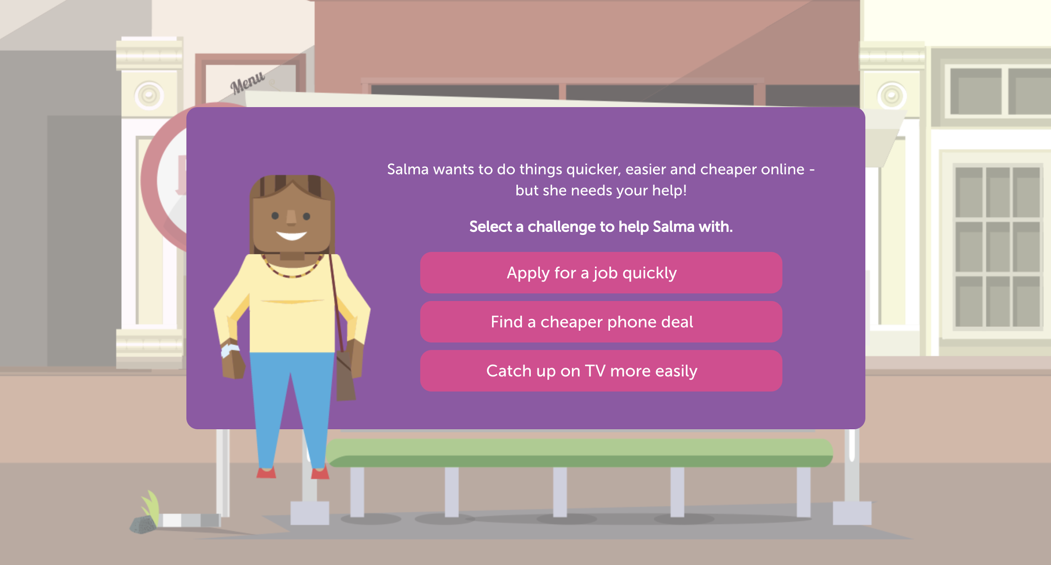
Online Lessons
License or develop self-driven online curriculum
Online Centres Network, UK

Slide 25




App Curation
Use existing apps to help people enhance everyday navigation of world
Mint
Google Maps
Apple Keychain
Google Drive

Slide 26
Personal Growth
Advancement of daily life tech abilities

Slide 27


Personal Growth
General Professional Development
Workplace productivity
Advanced “daily life communication” skills
Resumes, Cover letters, LinkedIn
Interview Etiquette, Attire, Body Language
Productivity software
Organization Tools
iPhone/laptop calendars
Microsoft Outlook

Slide 28
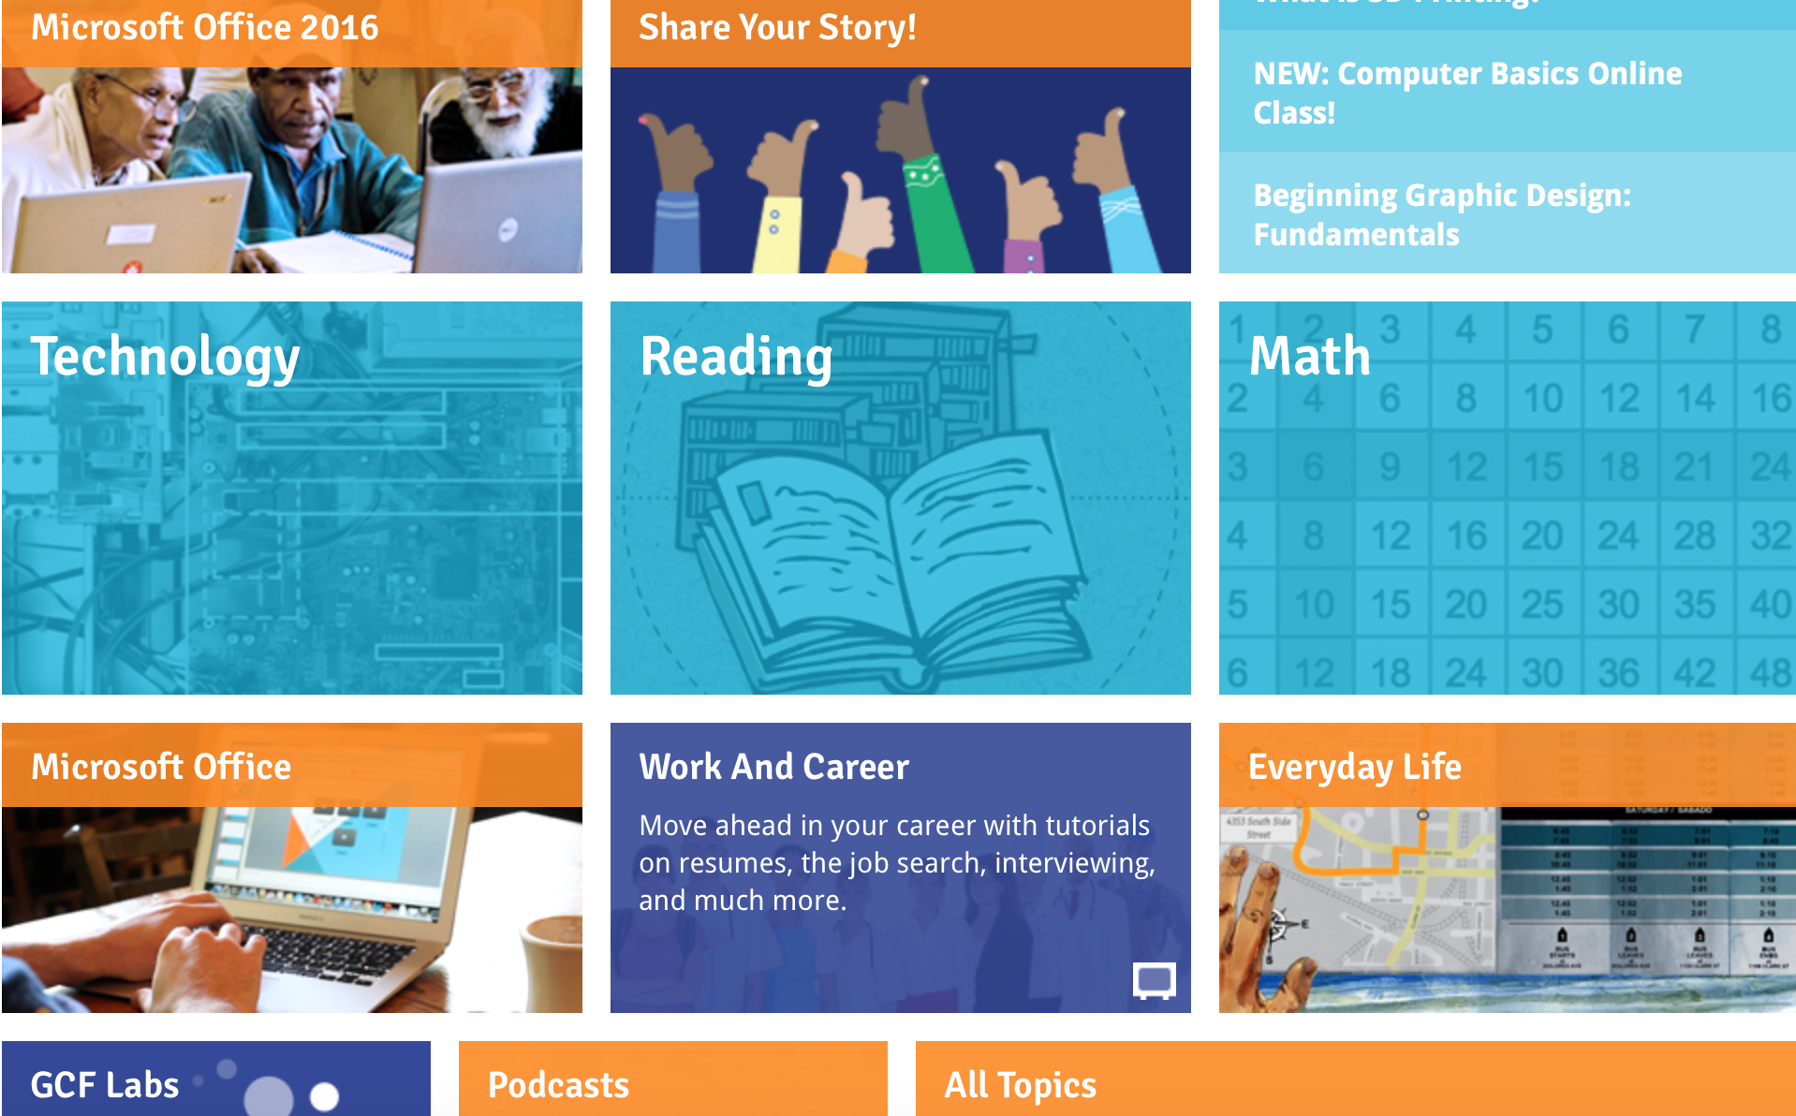
Implementation
Source: GCFLearnfree.org

Slide 29
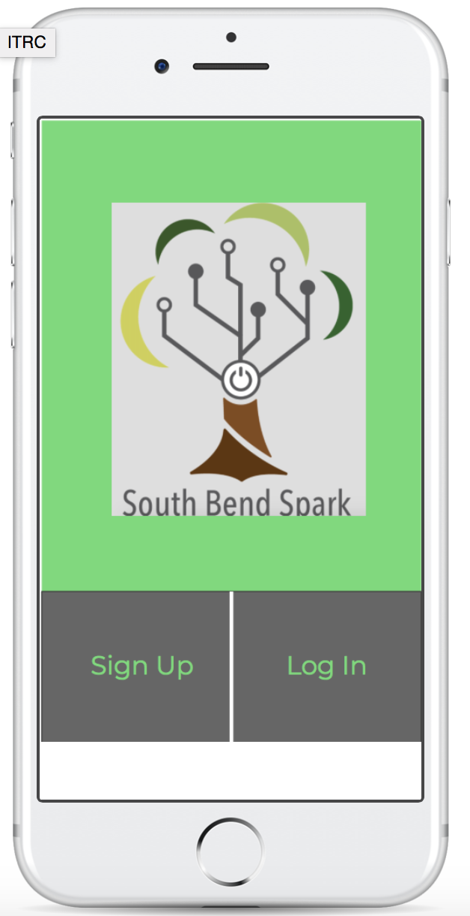
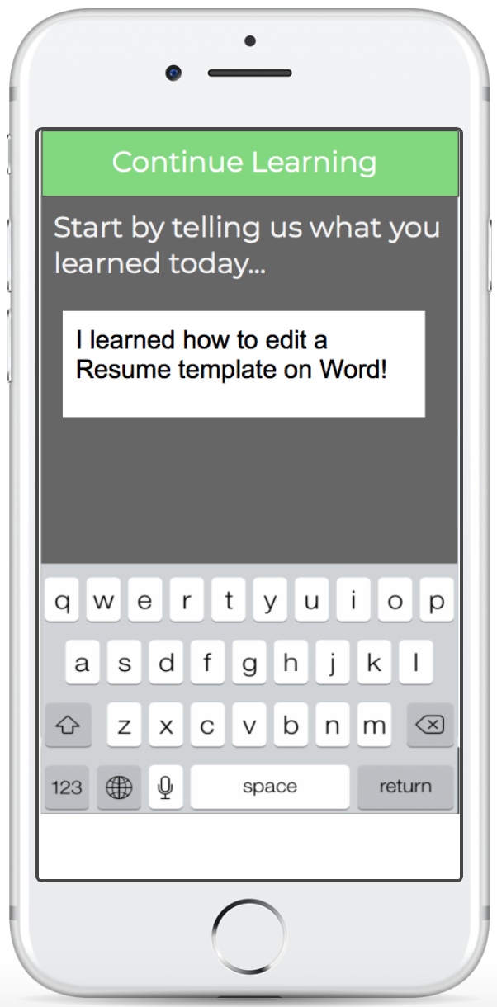
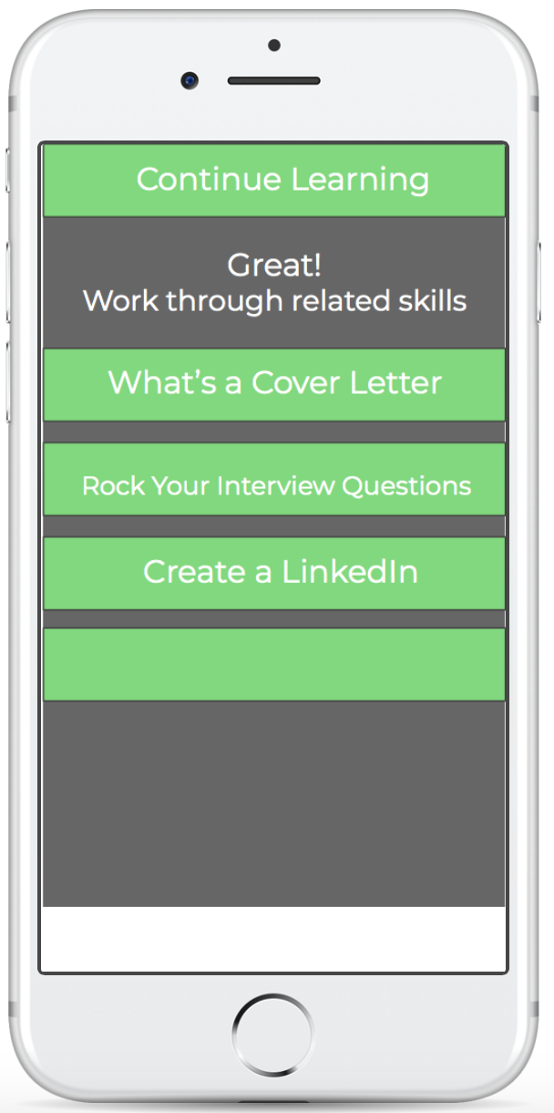


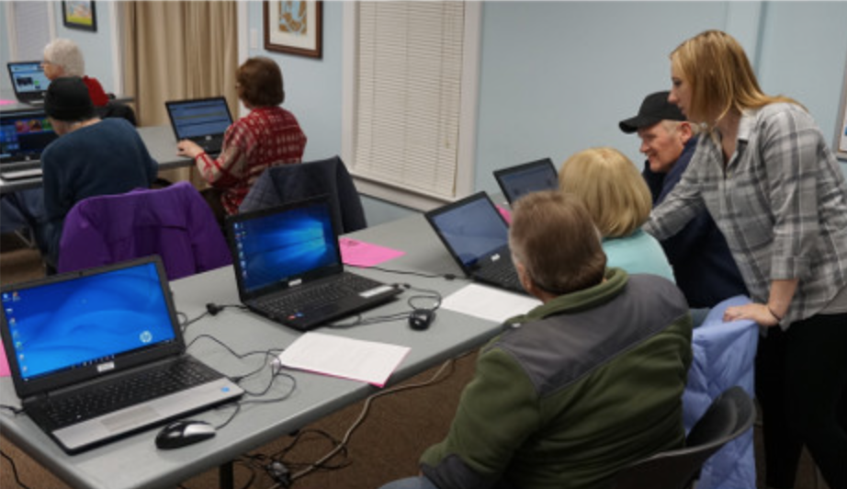
Implementation
Login at home to continue learning
Informal basics development
ttps://marvelapp.com/291hjei
Login back at SBSpark to show volunteers your progress and receive advanced training
Tech Confident and Personal Growth

Slide 30
Career Growth
Preparing job seekers and aiding in company efficiency

Slide 31

Aid employers & employees in utilizing tech more efficiently in the workplace

Slide 32

...For employers & their employees

Slide 33

Career Growth - Employer & their Employees
Create a space designated to training
Offer trainings that do not interfere with employee’s daily operations
Improve operating efficiency
Provide professional growth for all levels

Slide 34

Implementation
Utilize SBSpark’s main Hub
or SparkCart/SparkTruck to train on site
Companies provide SBSpark specific goals and consultants prepare tailored training on tech needs and software
Develop partnerships
Opportunity for ongoing revenue stream

Slide 35

...For Job Seekers

Slide 36

Career Growth - Job Seekers
Merge Gap between Job Seekers and Job Providers
Consultants Re-Default - redefine actual needs of local firms & form partnerships
Specific computer/tech skill tailored to Re-Defaults
Experiential learning - conveys job readiness

Slide 37
Implementation Overview
Re-Default Consultations
Create the Re-Defaults for given industry
Utilize formed partnerships to provide experiential learning
Physical recognition of skill development
Trainees become ambassadors

Slide 38

Implementation
1.
2.
Plastics
Email access
Resin cooling & treatment
Machine software Set up
Healthcare
Customer Service
Medical Records
Email access
Manufacturing
Excel data analysis
Machine logging
Production efficiency
Entrepreneurs
Website Templates
Logo & identity
Social Media

Slide 39
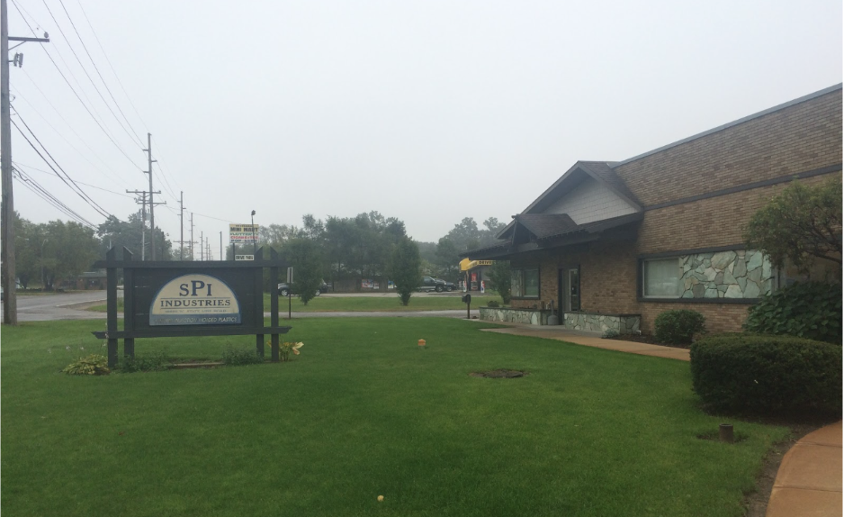


Implementation
3.
4.
Credible recognition of experience Hiring qualifications increase
SPI partner
SBSpark prepped learner
Jacob Burnett
Completes task that achieves experience skill outlined from Re- default consultation
Edgecam Automation
December 7, 2017
Samantha Walker
Notes:
chris still

Slide 40


Implementation
5.

